Slide 1
CSC479
Data Mining
Classification Lecture 9
Model Evaluation
(Ch # 8: Data Mining-Concepts and Techniques by Han and Kamber)

Slide 2
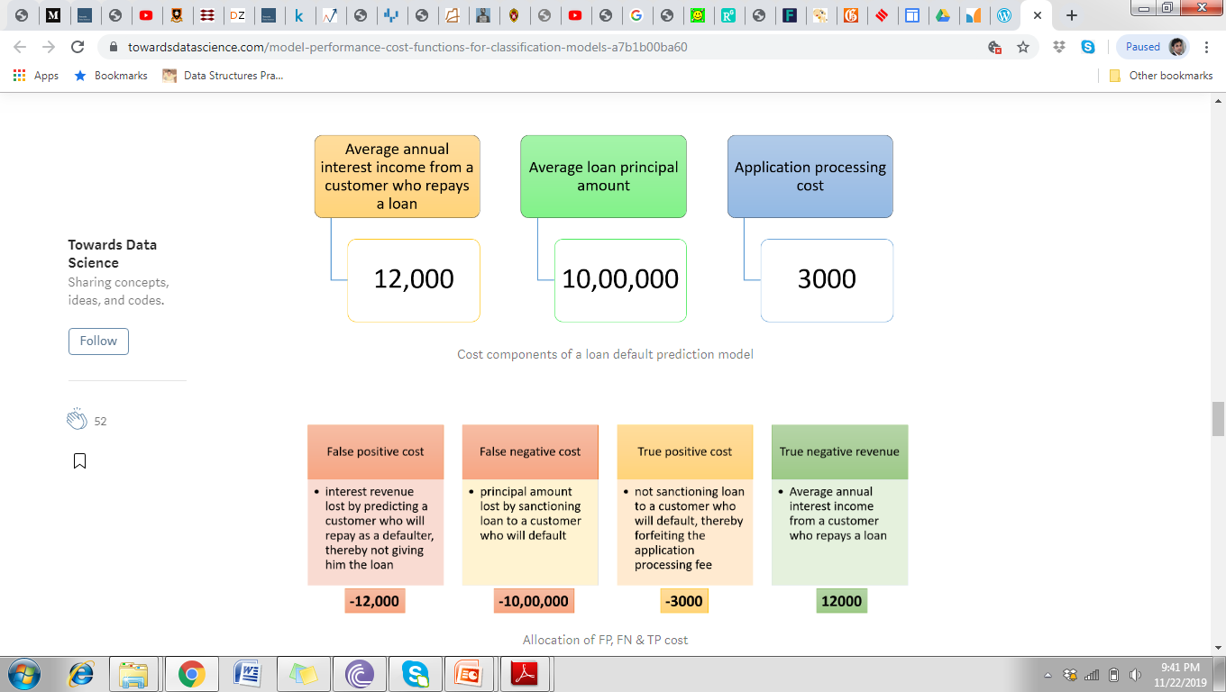
Computing Cost of Classification
Notes:
https://towardsdatascience.com/model-performance-cost-functions-for-classification-models-a7b1b00ba60

Slide 3
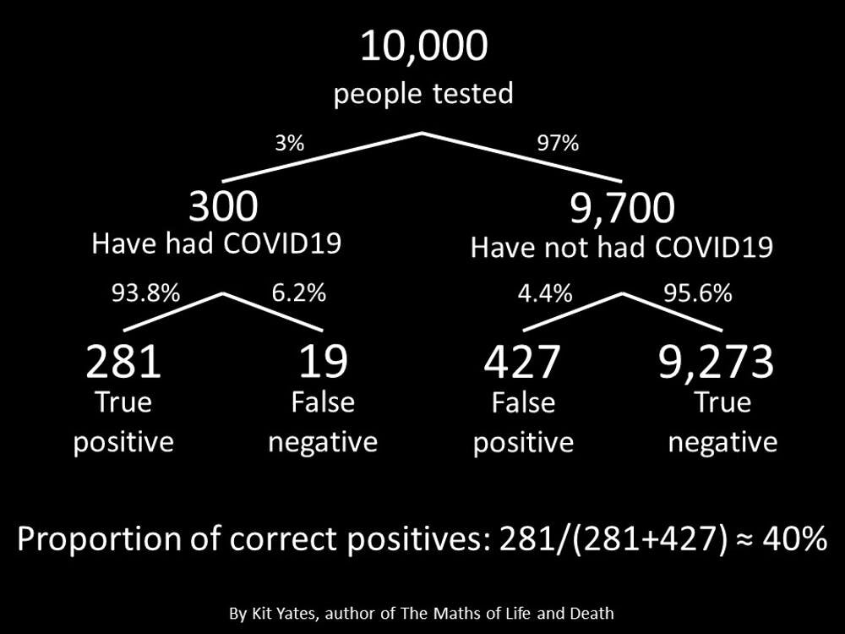

Slide 4
Computing Cost of Classification
Cost Matrix | PREDICTED CLASS
ACTUAL CLASS | C(i|j) | + | -
 | + | -1 | 100
 | - | 1 | 0
Model M₁ | PREDICTED CLASS
ACTUAL CLASS |  | + | -
 | + | 150 | 40
 | - | 60 | 250
Model M₂ | PREDICTED CLASS
ACTUAL CLASS |  | + | -
 | + | 250 | 45
 | - | 5 | 200
Accuracy = 80%
Cost = 3910
Accuracy = 90%
Cost = 4255

Slide 5
Cost vs Accuracy
Count | PREDICTED CLASS
ACTUAL CLASS |  | Class=Yes | Class=No
 | Class=Yes | a | b
 | Class=No | c | d
Accuracy is proportional to cost if 1. C(Yes|No)=C(No|Yes) = q 2. C(Yes|Yes)=C(No|No) = p
N = a + b + c + d
Accuracy = (a + d)/N
Cost = p (a + d) + q (b + c)
= p (a + d) + q (N – a – d)
= q N – (q – p)(a + d)
= N [q – (q-p) × Accuracy]
Cost | PREDICTED CLASS
ACTUAL CLASS |  | Class=Yes | Class=No
 | Class=Yes | p | q
 | Class=No | q | p

Slide 6
Precision-Recall
Count | PREDICTED CLASS
ACTUAL CLASS |  | Class=Yes | Class=No
 | Class=Yes | a | b
 | Class=No | c | d
Precision is biased towards C(Yes|Yes) & C(Yes|No)
Recall is biased towards C(Yes|Yes) & C(No|Yes)
F-measure is biased towards all except C(No|No)

Slide 7
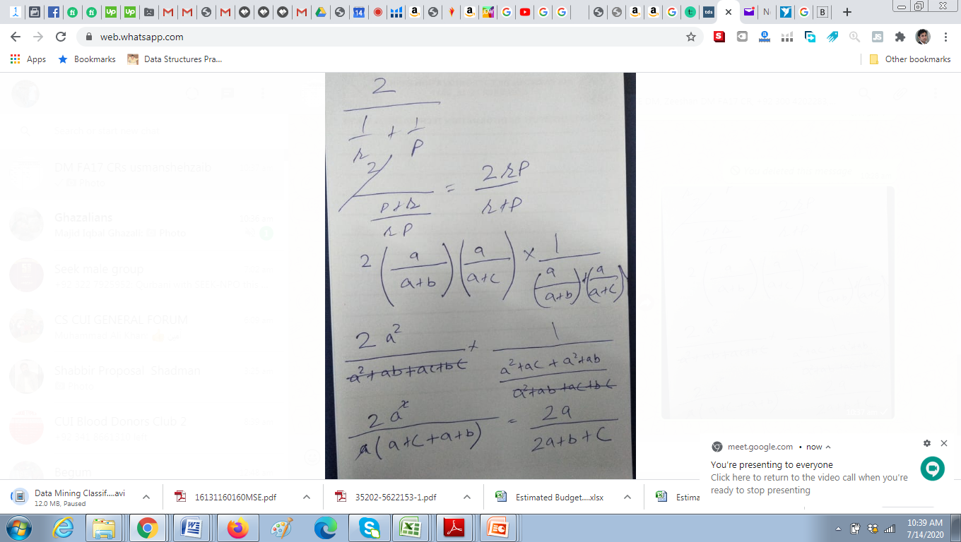

Slide 8
Precision-Recall plot
Precision-Recall is a useful measure of success of prediction when the classes are very imbalanced. In information retrieval, precision is a measure of result relevancy, while recall is a measure of how many truly relevant results are returned.

Slide 9
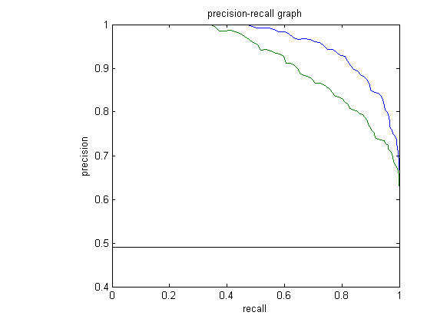
Precision-Recall plot
It shows the tradeoff between precision and recall for different threshold. A high area under the curve represents both high recall and high precision

Slide 10
Precision-Recall plot
high precision relates to a low false positive rate, and high recall relates to a low false negative rate. High scores for both show that the classifier is returning accurate results (high precision), as well as returning a majority of all positive results (high recall).

Slide 11
Precision-Recall plot
A system with high recall but low precision returns many results, but most of its predicted labels are incorrect when compared to the training labels. A system with high precision but low recall is just the opposite, returning very few results, but most of its predicted labels are correct when compared to the training labels.

Slide 12
Precision-Recall plot
An ideal system with high precision and high recall will return many results, with all results labeled correctly.

Slide 13
Evaluating Classifier Accuracy: Holdout & Cross-Validation Methods
Holdout method
Given data is randomly partitioned into two independent sets
Training set (e.g., 2/3) for model construction
Test set (e.g., 1/3) for accuracy estimation
Random sampling: a variation of holdout
Repeat holdout k times, accuracy = avg. of the accuracies obtained
Cross-validation (k-fold, where k = 10 is most popular)
Randomly partition the data into k mutually exclusive subsets, each approximately equal size
At i-th iteration, use D_{i} as test set and others as training set
Leave-one-out: k folds where k = # of tuples, for small sized data
13

Slide 14
Model Evaluation
Metrics for Performance Evaluation
How to evaluate the performance of a model?
Methods for Performance Evaluation
How to obtain reliable estimates?

Slide 15
Methods for Performance Evaluation
How to obtain a reliable estimate of performance?
Performance of a model may depend on other factors besides the learning algorithm:
Class distribution
Cost of misclassification
Size of training and test sets

Slide 16
Dealing with class Imbalance
If the class we are interested in is very rare, then the classifier will ignore it.
The class imbalance problem
Solution
We can modify the optimization criterion by using a cost sensitive metric
We can balance the class distribution
Sample from the larger class so that the size of the two classes is the same
Replicate the data of the class of interest so that the classes are balanced
Over-fitting issues

Slide 17
Classification of Class-Imbalanced Data Sets
Typical methods for imbalance data in 2-class classification:
Oversampling: re-sampling of data from positive class
Under-sampling: randomly eliminate tuples from negative class
Threshold-moving: moves the decision threshold, t, so that the rare class tuples are easier to classify, and hence, less chance of costly false negative errors
Ensemble techniques: Ensemble multiple classifiers introduced above
17

